Slide 1
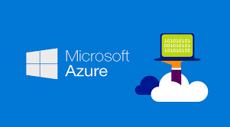
LEC-37 - Cloud Platforms in Industry (Microsoft Azure) (Microsoft Azure)

Slide 2
What is Microsoft Azure ?
Microsoft Azure, often referred to as Azure, is a cloud computing platform operated by Microsoft that provides access, management, and development of applications and services via globally-distributed data centers.
It provides a broad range of cloud services, including compute, analytics, storage and networking.
Users can pick and choose from these services to develop and scale new applications or run existing applications in the public cloud.

Slide 3
What is Microsoft Azure Used For?
Microsoft Azure is a cloud computing service that provides virtual servers and storage.
It allows you to quickly deploy applications and run them in the cloud, while also giving you access to a large network of other users.
You can use Azure to run web apps, mobile apps, and more. Azure is available in several different subscription plans, so you can choose what’s right for your needs.
It’s commonly used for things like building websites and running databases, among other things. With Microsoft’s recent launches of Azure Kubernetes Service (AKS) and Azure Container Service (ACS), microservice adoption has gained momentum in enterprises

Slide 4
What is Microsoft Azure Architecture?
Microsoft Azure is a cloud computing platform that lets you create, deploy and manage applications and services. It provides tools such as machine learning, mobile app development, and IoT solutions. This service can be used to run any type of application or service.
The Azure platform is available on multiple devices like PCs, laptops, smartphones, and tablets. It supports many programming languages including HTML5, JavaScript, PHP, Python, C# and more.

Slide 5
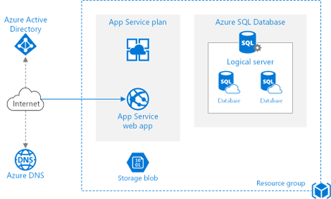
Diagram of AZURE.

Slide 6
Microsoft Azure Features.
Improved Backup and Disaster Recovery-
Microsoft Azure offers flexibility, advanced site recovery, and built-in integration. The cloud-based nature of Azure makes it innately flexible, allowing you to backup your data in virtually any programming language, operating system, or location. Azure also allows you to set backup schedules daily, weekly, monthly, or whatever schedule you please.

Slide 7
Develop and Host Web and Mobile Apps -
Azure is an ideal platform for developing, hosting, and managing web and mobile apps, making them autonomous and adaptive through features like automatic patch management, AutoScale, and integration for on-premise apps.

Slide 8
Integration with Active Directory –
Microsoft Azure can integrate with your Active Directory, supplementing your existing access and identity capabilities. It also gives your DNS improved security, worldwide reach, and centralized management.

Slide 9

Cloud Platforms in Industry (Case studies) Company name – Deloitte

Slide 10
Cloud Platforms in Industry (Case studies)
Company Name - Deloitte Touche Tohmatsu Limited, a UK private company.
Explore case studies to learn how Deloitte create Cloud is helping clients design and realize the future of their business.
Discover how Deloitte helped a global chemical company deploy a cloud-based enterprise integration platform and modernize its technology.

Slide 11
Case Study of cloud platforms.
A global chemical company planned a multiyear integration program to implement (Systems, Applications & Products which provides multiple business functions )SAP 4 /HANA (High-performance Analytic Appliance) which is multi-model database that stores data in its memory in the cloud, with the aim of folding not only IT but also plant operational technologies into the outcome. The company had to align operations across six continents and needed to be operational on an abbreviated two-year timetable—a tight deadline with its current resources.
As part of this program, the company had to modernize its integration platform required to process a high-volume of messages, spanning across multiple business domains, to be interchanged between diverse systems—on-premises and on the cloud—and trading partners.
The company worked with Deloitte to conduct an integration platform as a service (iPaaS) vendor assessment and eventually decided to move forward with Microsoft Azure Integration Services. Together, with Deloitte, the company beat its own demanding deadline and stood up the new cloud platform to provide integration capabilities, clear processes, documentation, an IT/OT integration framework, and skills for future growth.

Slide 12
Thanks

